Slide 1

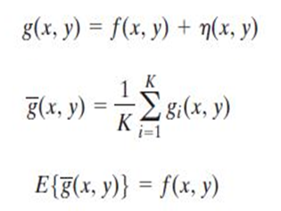
Digital Image Processing
8-prove using mathematical equations that adding different images for the same scene (with noisy images) and averaging them will give the original image without noise.
n> additional noise, f >original image, g- > avg , g > noisy image
Adding noise > reduces image quality

